Slide 1
Discrete Mathematics and Its Applications
Kenneth H. Rosen
Graphs
Slides by Sylvia Sorkin, Community College of Baltimore County - Essex Campus

Slide 2
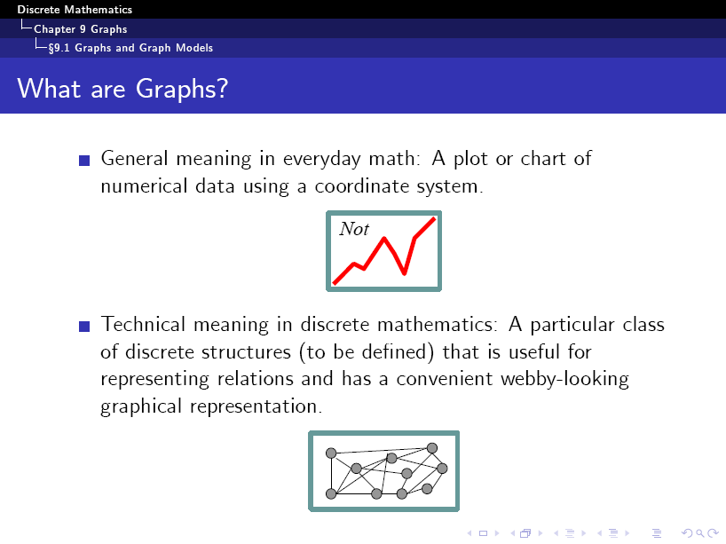

Slide 3
Simple Graph
Definition 1. A simple graph G = (V, E) consists of V, a nonempty set of vertices, and E, a set of unordered pairs of distinct elements of V called edges.

Slide 4
A simple graph
Detroit
New York
San Francisco
Chicago
Denver
Washington
Los Angeles
How many vertices? How many edges?

Slide 5
A simple graph
SET OF VERTICES
V = { Chicago, Denver, Detroit, Los Angeles,
New York, San Francisco, Washington }
SET OF EDGES
E = { {San Francisco, Los Angeles}, {San Francisco, Denver},
{Los Angeles, Denver}, {Denver, Chicago},
{Chicago, Detroit}, {Detroit, New York},
{New York, Washington}, {Chicago, Washington},
{Chicago, New York} }

Slide 6
A simple graph
Detroit
New York
San Francisco
Chicago
Denver
Washington
Los Angeles
The network is made up of computers and telephone lines
between computers. There is at most 1 telephone line
between 2 computers in the network. Each line operates
in both directions. No computer has a telephone line to itself.
These are undirected edges,
each of which connects two distinct vertices, and
no two edges connect the same pair of vertices.

Slide 7
A Non-Simple Graph
Definition 2. In a multigraph G = (V, E) two or more edges may connect the same pair of vertices.

Slide 8
A Multigraph
THERE CAN BE MULTIPLE TELEPHONE LINES
BETWEEN TWO COMPUTERS IN THE NETWORK.
Detroit
New York
San Francisco
Chicago
Denver
Washington
Los Angeles

Slide 9
Multiple Edges
Detroit
New York
San Francisco
Chicago
Denver
Washington
Los Angeles
Two edges are called multiple or parallel edges
if they connect the same two distinct vertices.

Slide 10
Another Non-Simple Graph
Definition 3. In a pseudograph G = (V, E) two or more edges may connect the same pair of vertices, and in addition, an edge may connect a vertex to itself.

Slide 11
A Pseudograph
THERE CAN BE TELEPHONE LINES IN THE NETWORK
FROM A COMPUTER TO ITSELF (for diagnostic use).
Detroit
New York
San Francisco
Chicago
Denver
Washington
Los Angeles

Slide 12
Loops
Detroit
New York
San Francisco
Chicago
Denver
Washington
Los Angeles
An edge is called a loop
if it connects a vertex to itself.

Slide 13
Undirected Graphs
pseudographs
multigraphs
simple graphs

Slide 14
A Directed Graph
Definition 4. In a directed graph G = (V, E) the edges are ordered pairs of (not necessarily distinct) vertices.

Slide 15
A Directed Graph
SOME TELEPHONE LINES IN THE NETWORK
MAY OPERATE IN ONLY ONE DIRECTION .
Those that operate in two directions are represented
by pairs of edges in opposite directions.
Detroit
New York
Chicago
San Francisco
Denver
Washington
Los Angeles

Slide 16
A Directed Multigraph
Definition 5. In a directed multigraph G = (V, E) the edges are ordered pairs of (not necessarily distinct) vertices, and in addition there may be multiple edges.

Slide 17
A Directed Multigraph
THERE MAY BE SEVERAL ONE-WAY LINES
IN THE SAME DIRECTION FROM ONE COMPUTER
TO ANOTHER IN THE NETWORK.
Detroit
New York
Chicago
San Francisco
Denver
Washington
Los Angeles

Slide 18
Types of Graphs
TYPE EDGES MULTIPLE EDGES LOOPS
ALLOWED? ALLOWED?
Simple graph Undirected NO NO
Multigraph Undirected YES NO
Pseudograph Undirected YES YES
Directed graph Directed NO YES
Directed multigraph Directed YES YES

Slide 19
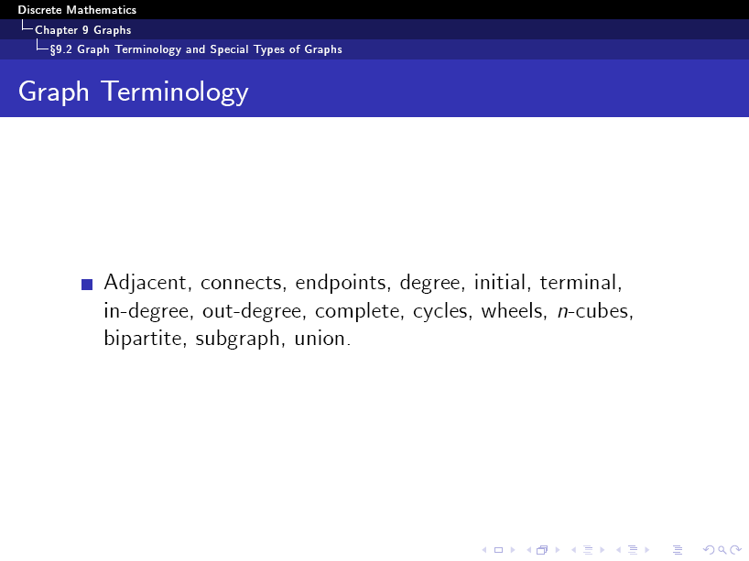

Slide 20
Adjacent Vertices (Neighbors)
Definition 1. Two vertices, u and v in an undirected graph G are called adjacent (or neighbors) in G, if {u, v} is an edge of G.
An edge e connecting u and v is called incident with vertices u and v, or is said to connect u and v. The vertices u and v are called endpoints of edge {u, v}.

Slide 21
Degree of a vertex
Definition 1. The degree of a vertex in an undirected graph is the number of edges incident with it, except that a loop at a vertex contributes twice to the degree of that vertex.
c
d
deg( d ) = 1
b
a
g
f
e

Slide 22
Degree of a vertex
Definition 1. The degree of a vertex in an undirected graph is the number of edges incident with it, except that a loop at a vertex contributes twice to the degree of that vertex.
c
d
b
deg( e ) = 0
a
g
f
e

Slide 23
Degree of a vertex
Definition 1. The degree of a vertex in an undirected graph is the number of edges incident with it, except that a loop at a vertex contributes twice to the degree of that vertex.
c
d
deg( b ) = 6
b
a
g
f
e

Slide 24
Degree of a vertex
Find the degree of all the other vertices.
deg( a ) deg( c ) deg( f ) deg( g )
c
d
deg( b ) = 6
deg( d ) = 1
b
deg( e ) = 0
a
g
f
e

Slide 25
Degree of a vertex
Find the degree of all the other vertices.
deg( a ) = 2 deg( c ) = 4 deg( f ) = 3 deg( g ) = 4
c
d
deg( b ) = 6
deg( d ) = 1
b
deg( e ) = 0
a
g
f
e

Slide 26
Degree of a vertex
Find the degree of all the other vertices.
deg( a ) = 2 deg( c ) = 4 deg( f ) = 3 deg( g ) = 4
TOTAL of degrees = 2 + 4 + 3 + 4 + 6 + 1 + 0 = 20
c
d
deg( b ) = 6
deg( d ) = 1
b
deg( e ) = 0
a
g
f
e

Slide 27
Degree of a vertex
Find the degree of all the other vertices.
deg( a ) = 2 deg( c ) = 4 deg( f ) = 3 deg( g ) = 4
TOTAL of degrees = 2 + 4 + 3 + 4 + 6 + 1 + 0 = 20
TOTAL NUMBER OF EDGES = 10
c
d
deg( b ) = 6
deg( d ) = 1
b
deg( e ) = 0
a
g
f
e

Slide 28
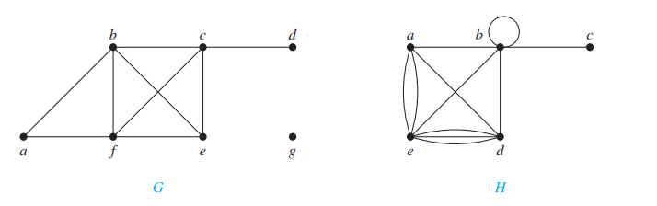
What are the degrees and what are the neighborhoods of the vertices in the graphs G and H displayed in Figure 1
In G, deg(a) = 2, deg(b) = deg(c) = deg(f ) = 4, deg(d ) = 1, deg(e) = 3, and deg(g) = 0. The neighborhoods of these vertices are N(a) = {b, f }, N(b) = {a, c, e, f }, N(c) = {b, d, e, f }, N(d) = {c}, N(e) = {b, c, f }, N(f ) = {a, b, c, e}, and N(g) = ∅.
In H, deg(a) = 4, deg(b) = deg(e) = 6, deg(c) = 1, and deg(d ) = 5. The neighborhoods of these vertices are N(a) = {b, d, e}, N(b) = {a, b, c, d, e}, N(c) = {b}, N(d) = {a, b, e}, and N(e) = {a, b, d}.

Slide 29
Handshaking Theorem
Theorem 1. Let G = (V, E) be an undirected graph G with e edges. Then
∑ deg( v ) = 2 e
v ε V
“The sum of the degrees over all the vertices equals twice the number of edges.”
NOTE: This applies even if multiple edges and loops are present.

Slide 30
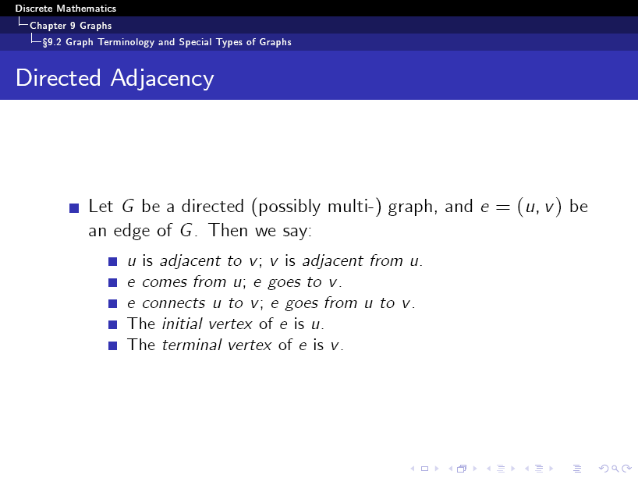

Slide 31
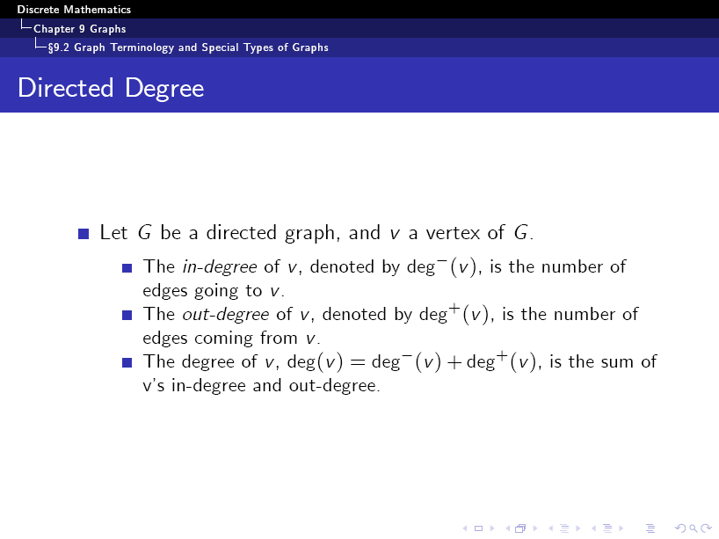

Slide 32
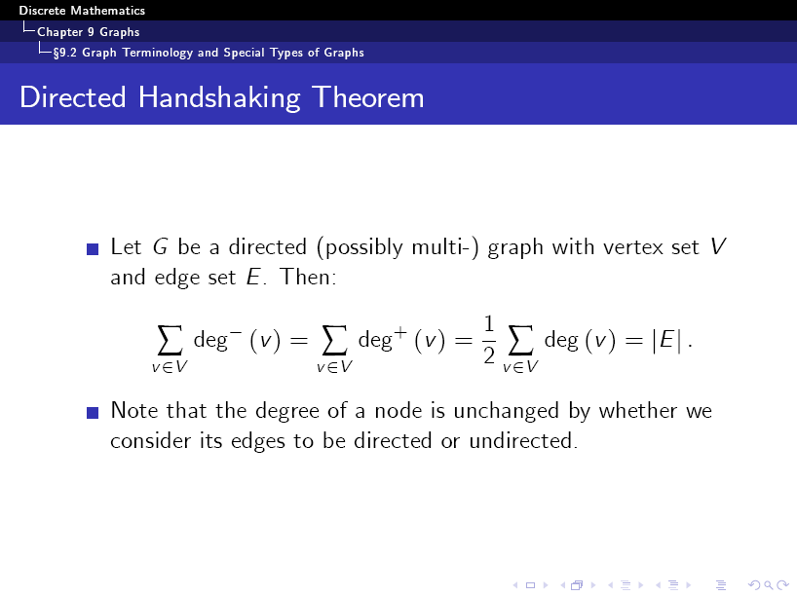

Slide 33
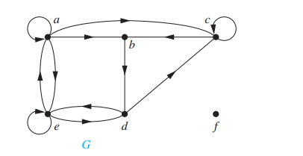
Find the in-degree and out-degree of each vertex in the graph G with directed edges shown in Figure 2
The in-degrees in G are deg-(a) = 2, deg-(b) = 2, deg-(c) = 3, deg-(d) = 2, deg-(e) = 3, and deg-(f ) = 0. The out-degrees are deg+(a) = 4, deg+(b) = 1, deg+(c) = 2, deg+(d) = 2, deg+(e) = 3, and deg+(f ) = 0.
Because each edge has an initial vertex and a terminal vertex, the sum of the in-degrees and the sum of the out-degrees of all vertices in a graph with directed edges are the same. Both of these sums are the number of edges in the graph.

Slide 34
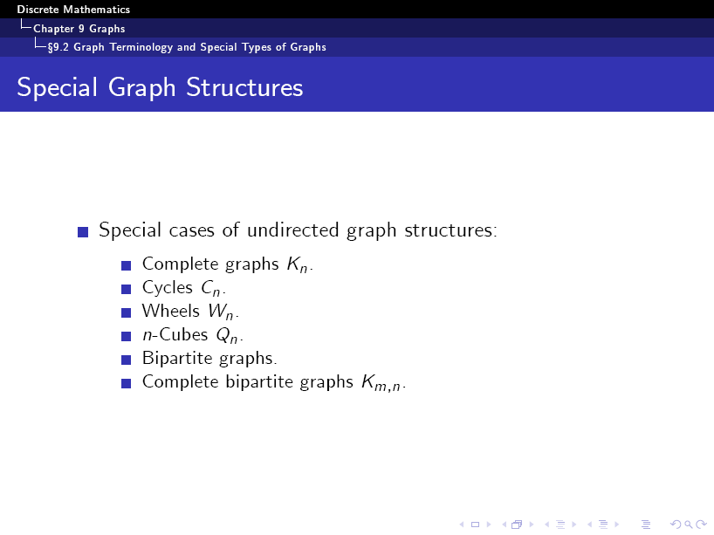

Slide 35
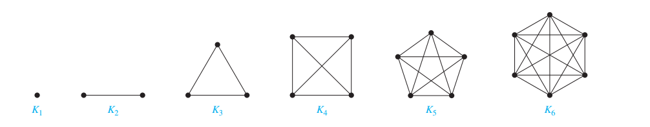
Complete Graphs: A complete graph on n vertices, denoted by Kn, is a simple graph that contains exactly one edge between each pair of distinct vertices.
The graphs Kn, for n = 1, 2, 3, 4, 5, 6, are displayed in Figure. A simple graph for which there is at least one pair of distinct vertex not connected by an edge is called noncomplete.
The Graphs Kn for 1 ≤ n ≤ 6.

Slide 36
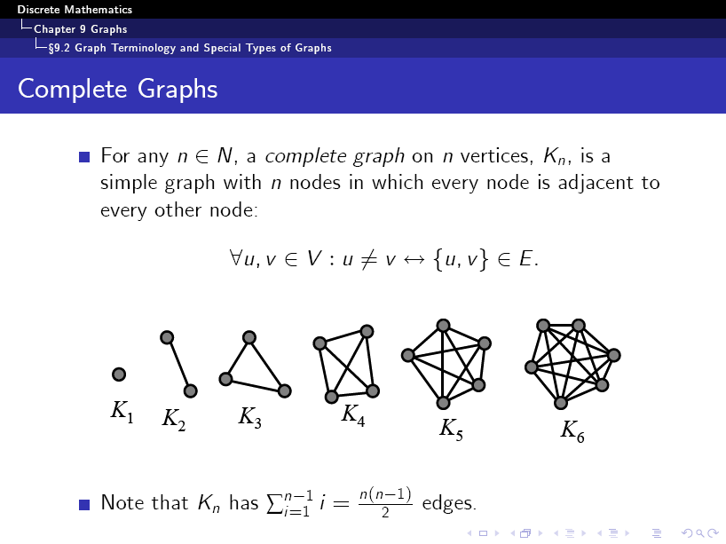

Slide 37
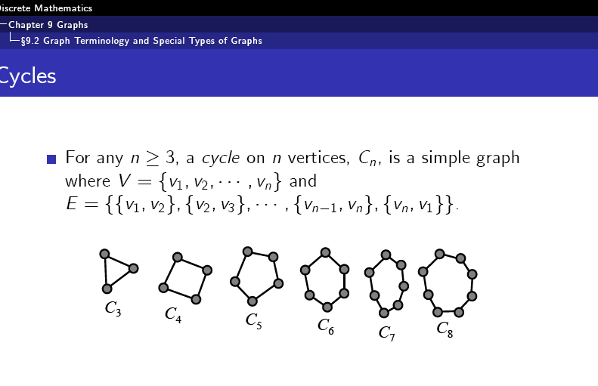

Slide 38
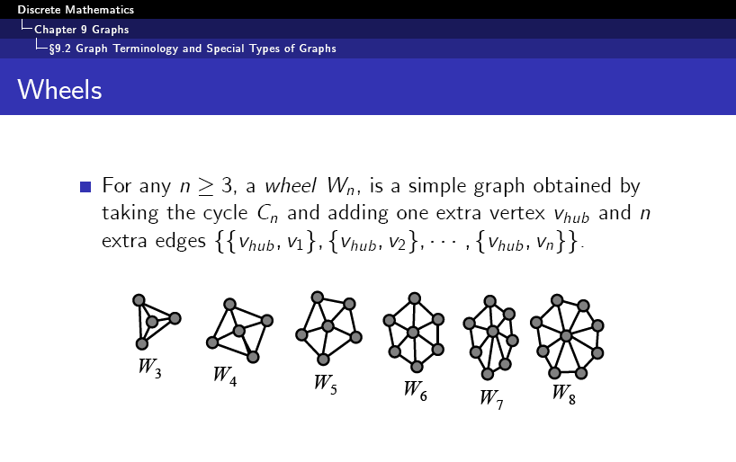
Wheels We obtain a wheel Wn when we add an additional vertex to a cycle Cn, for n ≥ 3, and connect this new vertex to each of the n vertices in Cn, by new edges

Slide 39
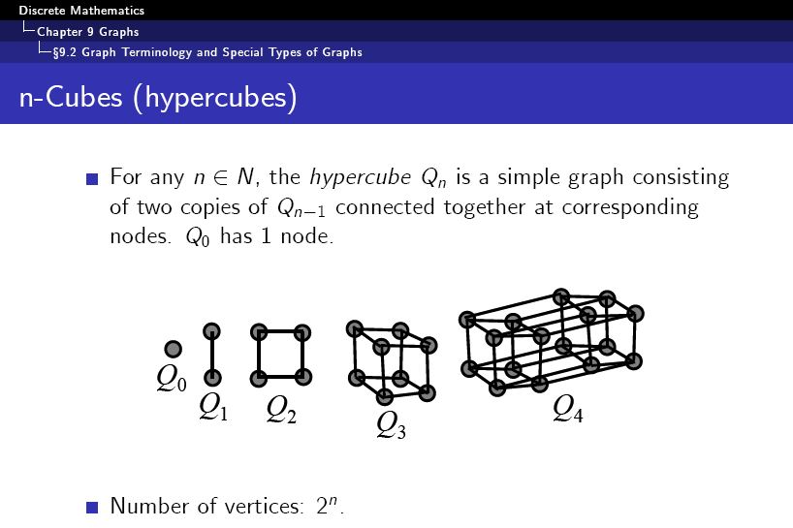

Slide 40
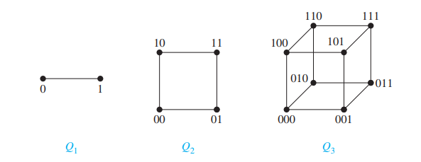

An n-dimensional hypercube, or n-cube, denoted by Q_{n}, is a graph that has vertices representing the 2^{n} bit strings of length n. Two vertices are adjacent if and only if the bit strings that they represent differ in exactly one bit position.

Slide 41
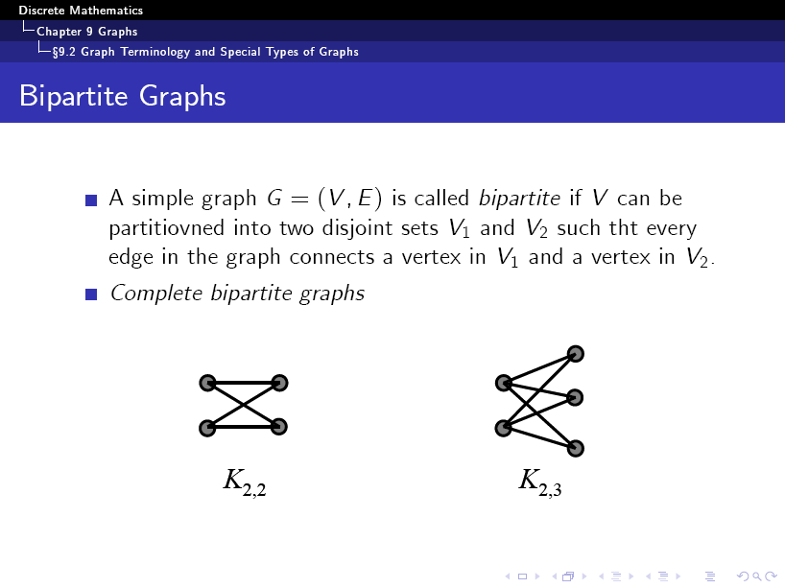

Slide 42
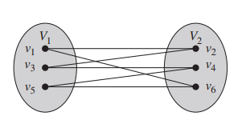
A simple graph G is called bipartite if its vertex set V can be partitioned into two disjoint sets V1 and V2 such that every edge in the graph connects a vertex in V1 and a vertex in V2 (so that no edge in G connects either two vertices in V1 or two vertices in V2). When this condition holds, we call the pair (V1, V2) a bipartition of the vertex set V of G.
It is bipartite, because its vertex set can be partitioned into the two sets V1 = {v1, v3, v5} and V2 = {v2, v4, v6}, and every edge of this graph connects a vertex in V1 and a vertex in V2.
It is not bipartite. To verify this, note that if we divide the vertex set into two disjoint sets, one of the two sets must contain two vertices. If the graph were bipartite, these two vertices could not be connected by an edge, but in this graph each vertex is connected to every other vertex by an edge.

Slide 43
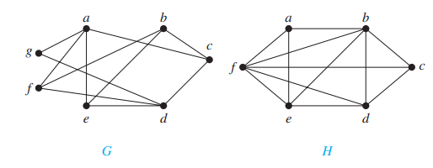
Graph G is bipartite because its vertex set is the union of two disjoint sets, {a, b, d} and {c, e, f, g}, and each edge connects a vertex in one of these subsets to a vertex in the other subset.
(Note that for G to be bipartite it is not necessary that every vertex in {a, b, d} be adjacent to every vertex in {c, e, f, g}. For instance, b and g are not adjacent.)
Graph H is not bipartite because its vertex set cannot be partitioned into two subsets so that edges do not connect two vertices from the same subset. (The reader should verify this by considering the vertices a, b, and f .)
A simple graph is bipartite if and only if it is possible to assign one of two different colors to each vertex of the graph so that no two adjacent vertices are assigned the same color.

Slide 44
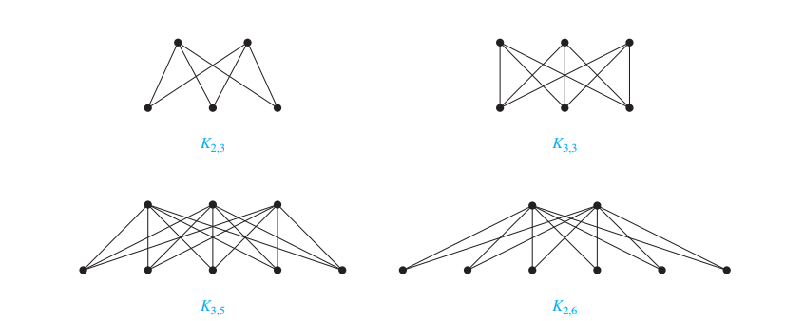
Complete Bipartite Graphs: A complete bipartite graph Km,n is a graph that has its vertex set partitioned into two subsets of m and n vertices, respectively with an edge between two vertices if and only if one vertex is in the first subset and the other vertex is in the second subset. The complete bipartite graphs K2,3, K3,3, K3,5, and K2,6 are displayed in Figure.

Slide 45
Subgraph
Definition 6. A subgraph of a graph G = (V, E) is a graph H = (W, F) where W ⊆ V and F ⊆ E.

Slide 46
C₅ is a subgraph of K₅
K₅
C₅

Slide 47
Union
Definition 7. The union of 2 simple graphs G₁ = ( V₁ , E₁ ) and G₂ = ( V₂ , E₂ ) is the simple graph with vertex set V = V₁ ∪ V₂ and edge set E = E₁ ∪ E₂ . The union is denoted by G₁ ∪ G₂ .

Slide 48
W₅ is the union of S₅ and C₅
c
b
d
c
c
f
a
e
c
b
d
f
S₅
a
b
d
a
e
e
W₅
a
e
C₅

Slide 49
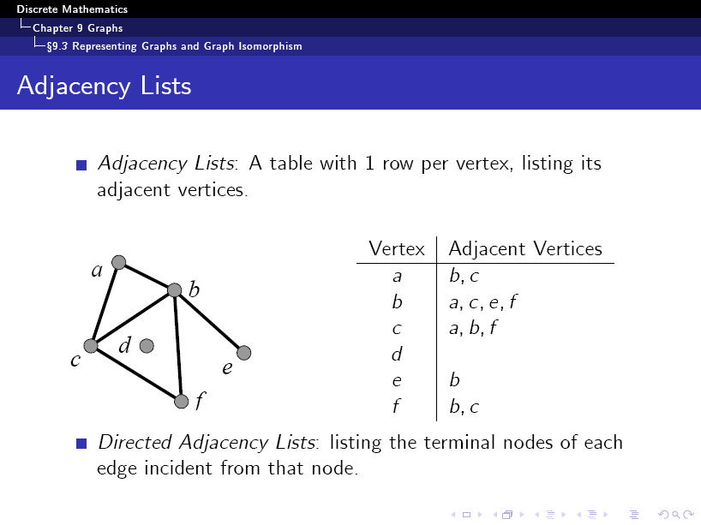

Slide 50
One way to represent a graph without multiple edges is to list all the edges of this graph.
Another way to represent a graph with no multiple edges is to use adjacency lists, which specify the vertices that are adjacent to each vertex of the graph.
Sometimes, two graphs have exactly the same form, in the sense that there is a one-to-one correspondence between their vertex sets that preserves edges.
In such a case, we say that the two graphs are isomorphic. Determining whether two graphs are isomorphic is an important problem of graph theory that we will study in this section.

Slide 51
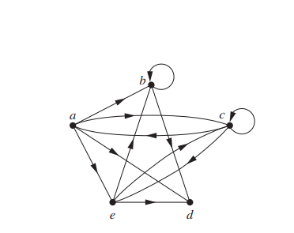
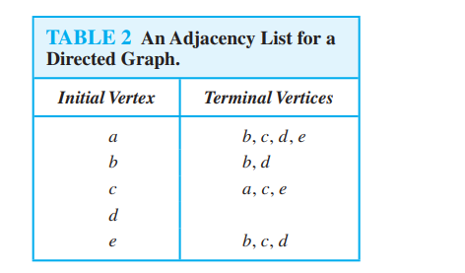


Slide 52
Suppose that G = (V, E) is a simple graph where |V | = n. Suppose that the vertices of G are listed arbitrarily as v1, v2, . . . , vn. The adjacency matrix A (or AG) of G, with respect to this listing of the vertices, is the n x n zero–one matrix with 1 as its (i, j)th entry when vi and vj are adjacent, and 0 as its (i, j)th entry when they are not adjacent. In other words, if its adjacency matrix is A = [aij], then

Slide 53
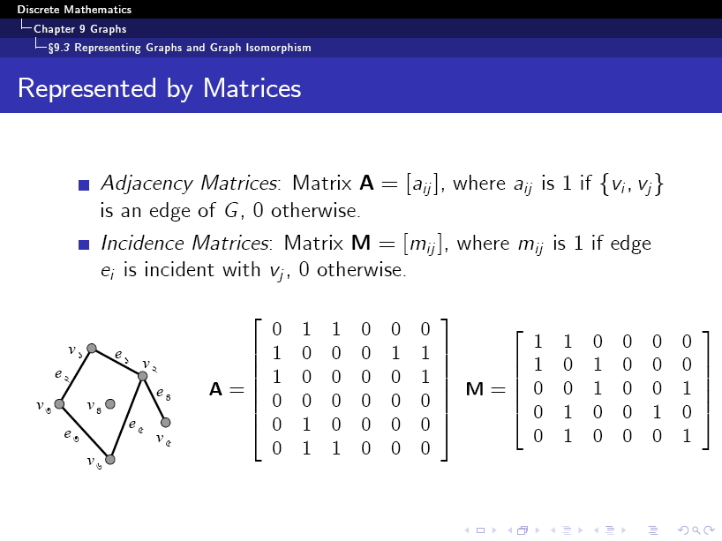

Slide 54
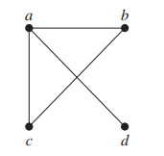
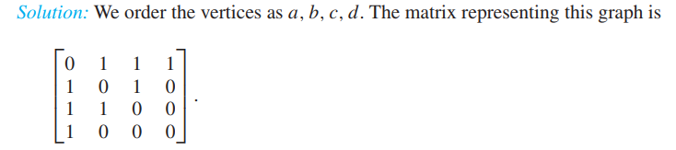
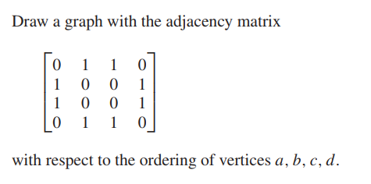
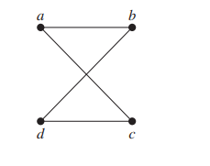

Slide 55

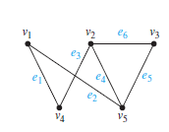
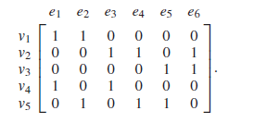
Incidence Matrices
Another common way to represent graphs is to use incidence matrices. Let G = (V ,E) be an undirected graph. Suppose that v1, v2, . . . , vn are the vertices and e1, e2, . . . , em are the edges of G. Then the incidence matrix with respect to this ordering of V and E is the n × m matrix M = [mij ], where
Represent the graph shown in Figure with an incidence matrix.

Slide 56
The simple graphs G1 = (V1, E1) and G2 = (V2, E2) are isomorphic if there exists a one to-one and onto function f from V1 to V2 with the property that a and b are adjacent in G1 if and only if f (a) and f (b) are adjacent in G2, for all a and b in V1. Such a function f is called an isomorphism.∗ Two simple graphs that are not isomorphic are called nonisomorphic.
In other words, when two simple graphs are isomorphic, there is a one-to-one correspondence between vertices of the two graphs that preserves the adjacency relationship. Isomorphism of simple graphs is an equivalence relation

Slide 57
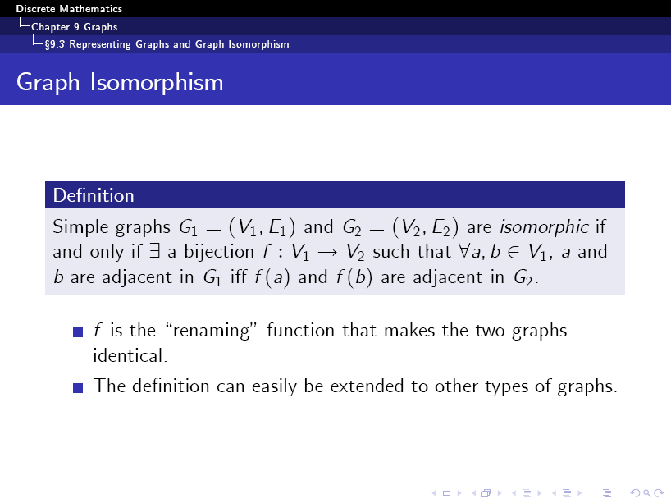

Slide 58
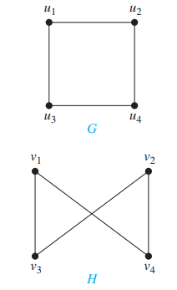
The function f with f (u1) = v1, f (u2) = v4, f (u3) = v3, and f (u4) = v2 is a oneto-one correspondence between V and W. To see that this correspondence preserves adjacency, note that adjacent vertices in G are u1 and u2, u1 and u3, u2 and u4, and u3 and u4, and each of the
pairs f (u1) = v1 and f (u2) = v4, f (u1) = v1 and f (u3) = v3, f (u2) = v4 and f (u4) = v2, and f (u3) = v3 and f (u4) = v2 consists of two adjacent vertices in H.
how that the graphs G = (V, E) and H = (W, F ), displayed in Figure, are isomorphic

Slide 59
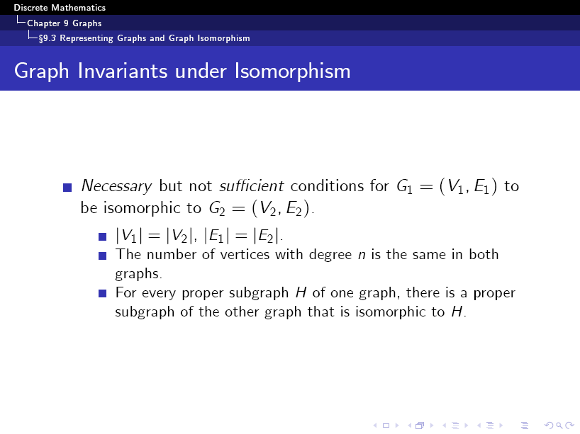

Slide 60
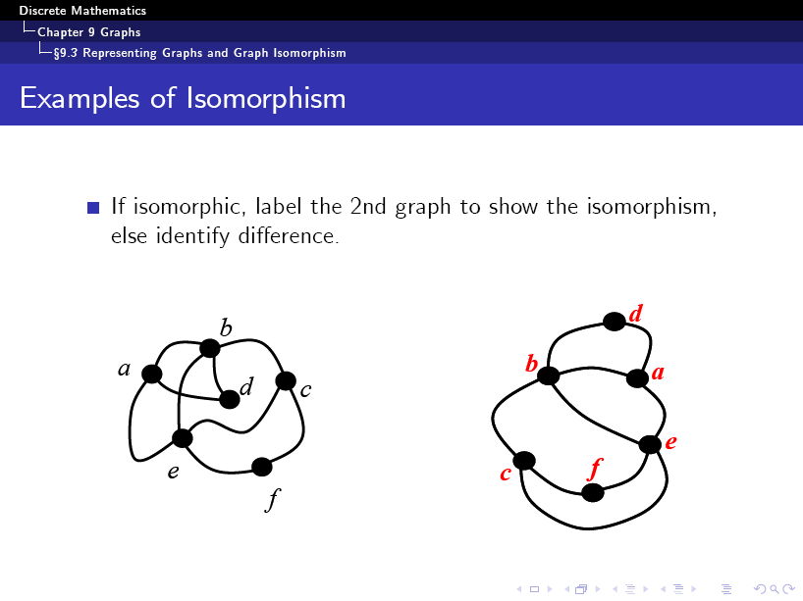

Slide 61
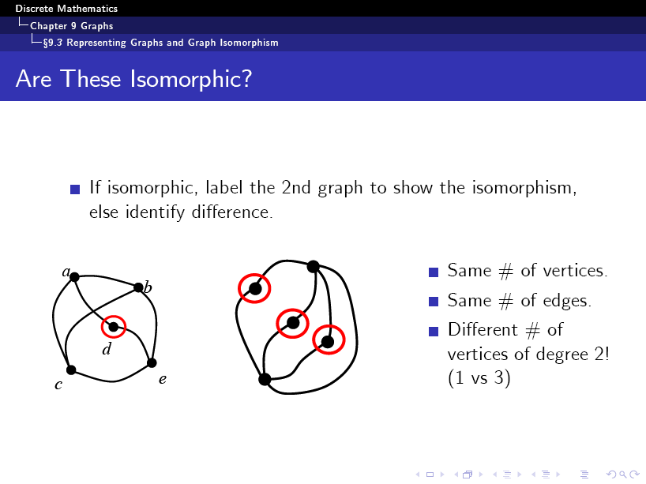

Slide 62
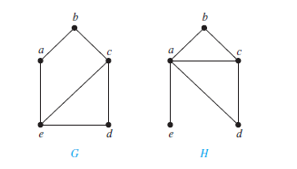
Determining whether Two Simple Graphs are Isomorphic
Show that the graphs displayed in Figure are not isomorphic
Both G and H have five vertices and six edges. However, H has a vertex of degree one, namely, e, whereas G has no vertices of degree one. It follows that G and H are not isomorphic.
Isomorphic simple graphs also must have the same number of edges, because the one-to-one correspondence between vertices establishes a one-to-one correspondence between edges.
In addition, the degrees of the vertices in isomorphic simple graphs must be the same. That is, a vertex v of degree d in G must correspond to a vertex f (v) of degree d in H, because a vertex w in G is adjacent to v if and only if f (v) and f (w) are adjacent in H.
The number of vertices, the number of edges, and the number of vertices of each degree are all invariants under isomorphism. If any of these quantities differ in two simple graphs, these graphs cannot be isomorphic.

Slide 63
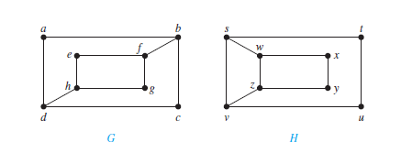
Determine whether the graphs shown in Figure are isomorphic
The graphs G and H both have eight vertices and 10 edges. They also both have four vertices of degree two and four of degree three. Because these invariants all agree, it is still conceivable that these graphs are isomorphic
However, G and H are not isomorphic. To see this, note that because deg(a) = 2 in G, a must correspond to either t , u, x, or y in H, because these are the vertices of degree two in H. However, each of these four vertices in H is adjacent to another vertex of degree two in H, which is not true for a in G.
Another way to see that G and H are not isomorphic is to note that the subgraphs of G and H made up of vertices of degree three and the edges connecting them must be isomorphic if these two graphs are isomorphic (the reader should verify this).

